Slide 1
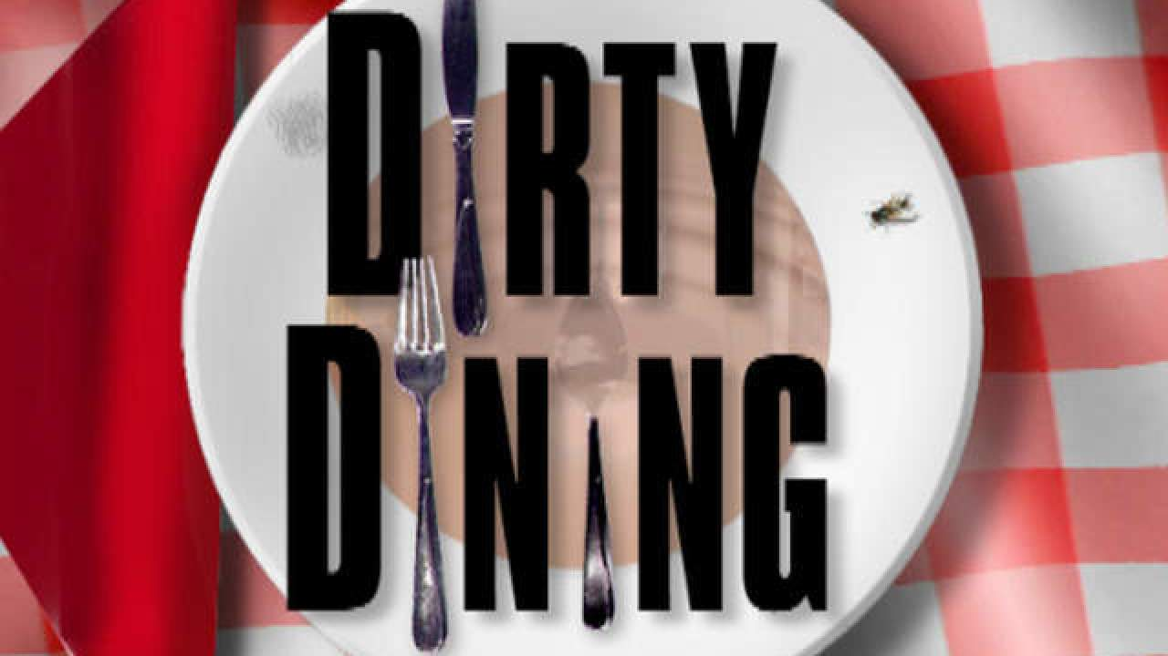

Slide 2
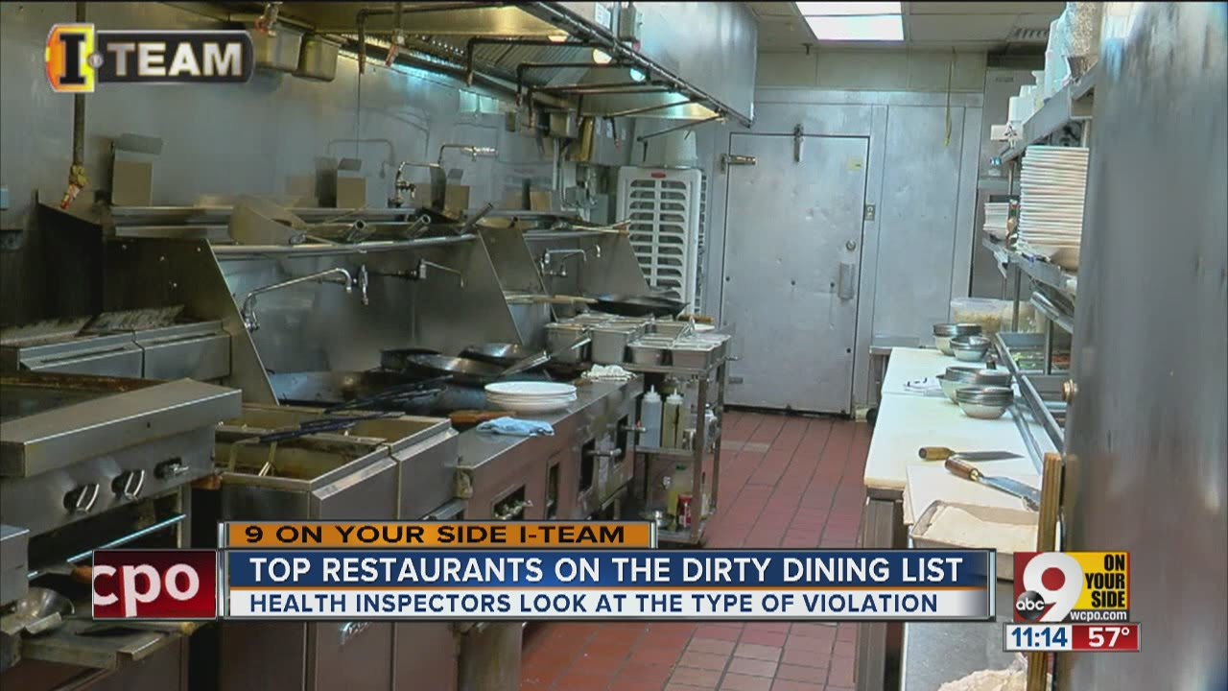
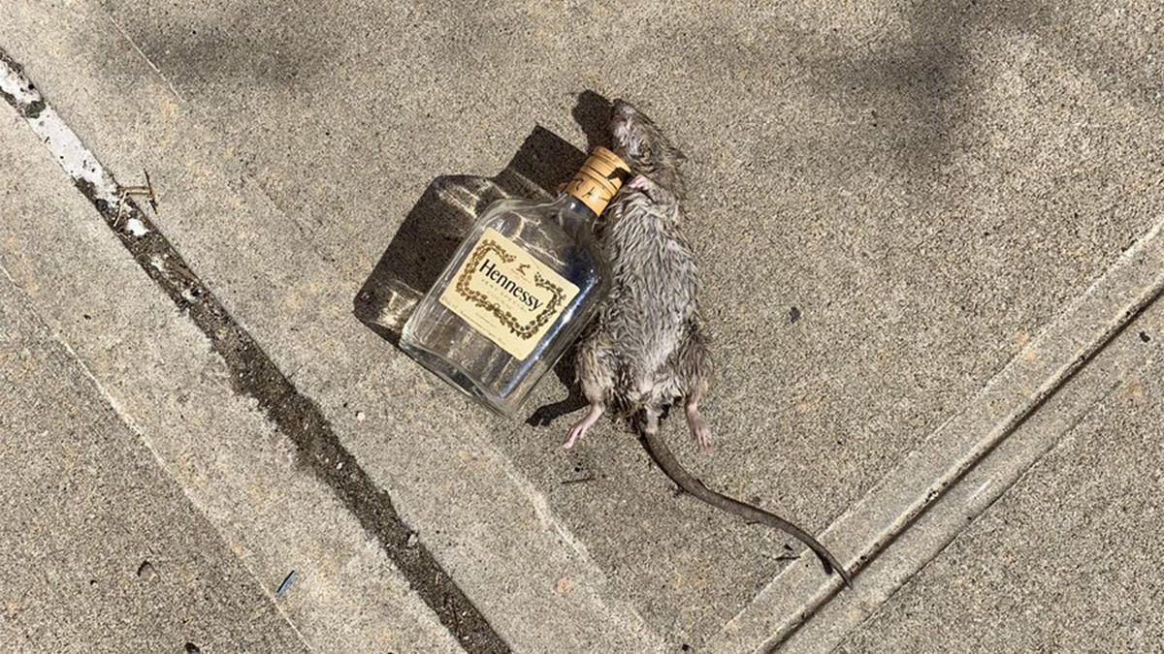
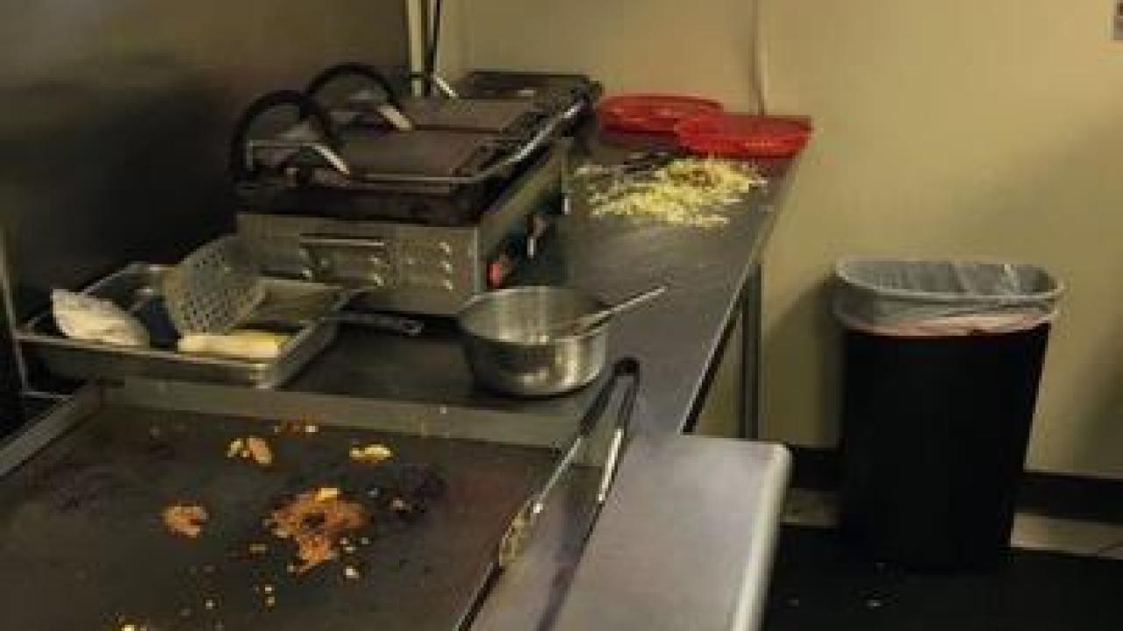
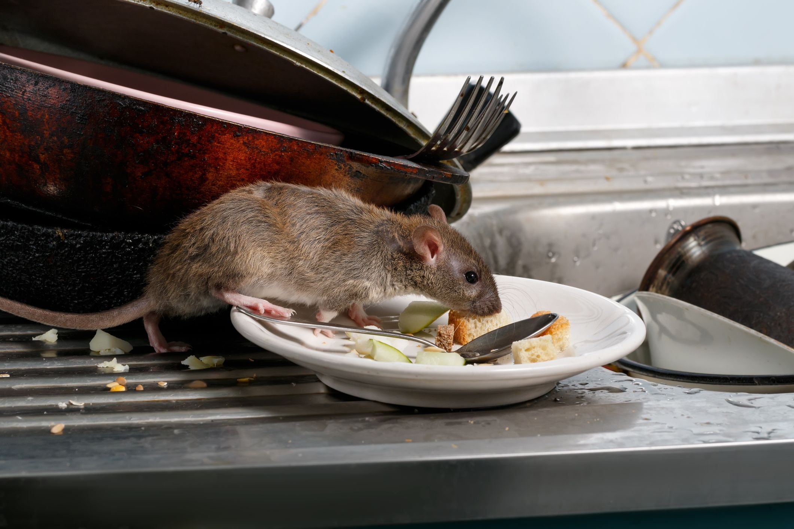
Objectives
Identify the dirtiest restaurants in NYC by borough and cuisine.
Determine if there is a correlation between rat sightings and critical violations

Slide 3
Study Methodology
Establish means to compare cleanliness
Normalize violations by taking average by zip code
Apples to apples comparison of cleanliness by zip
Provides context for the “proprietary” grade assigned to each restaurant

Slide 4
Is there a correlation between the average number of critical violations and rat sightings?

Slide 5
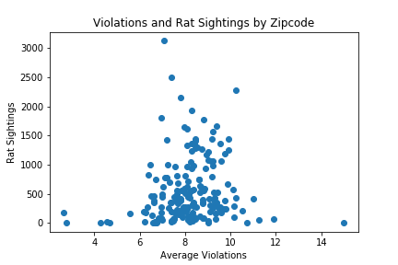
In NYC…
Results approach normal distribution
The large majority (~95%/1 StDev) of restaurants in NYC have a higher count of rat sightings

Slide 6
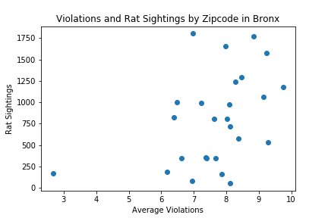
Bronx – High Violations, High Rat Sightings

Slide 7
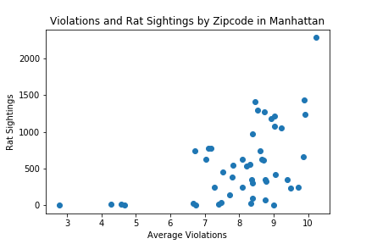
Manhattan – High Violations, High Rat Sightings

Slide 8
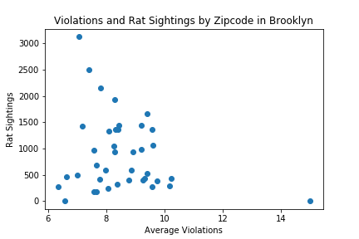
Brooklyn – High Rat Sightings, Low Violations

Slide 9
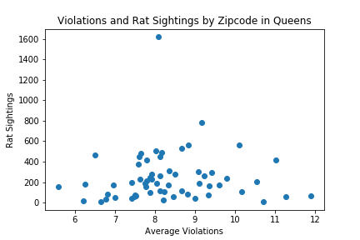
Queens – Unremarkable

Slide 10
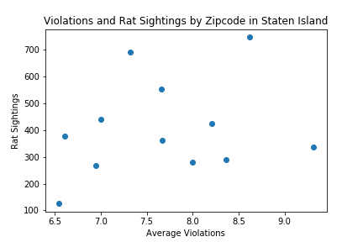
Staten Island – Shot Gun Blast

Slide 11
Dirtiest Restaurant Algorithm
Created bins based on Health Grade, Rat Sightings by Zip Code, Count of Critical Violations.
Assigned value based on quality
Dole out the least amount of weight to Health Grade(3 pts) and the most weight to Rat Sightings (5pts) and Count of Critical Violations (5pts).
Total Possible Score = 13
Score = Heath Grade + Rat Sightings + Count of Critical Violations/Total Possible Score
Sorted Score in descending order to determine “Top 5” dirtiest restaurants

Slide 12
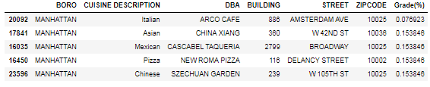
Dirtiest Restaurants in Manhattan

Slide 13
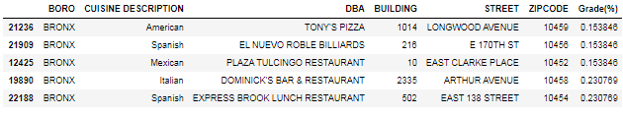
Dirtiest Restaurants in Bronx

Slide 14
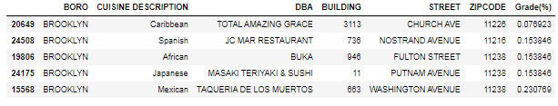
Dirtiest Restaurants in Brooklyn

Slide 15
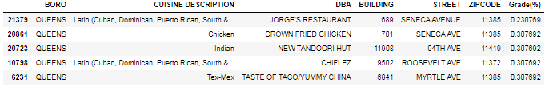
Dirtiest Restaurants in Queens

Slide 16
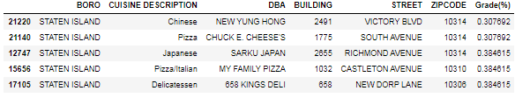
Dirtiest Restaurants in Staten Island

Slide 17
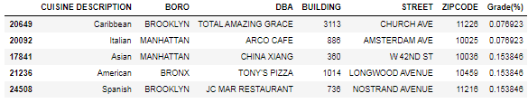
Dirtiest Restaurants by Cuisine

Slide 18
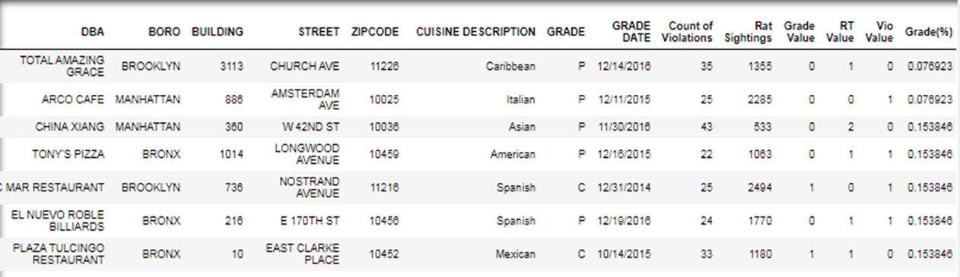
What the Analysis Found
Normal distribution between rat sightings and critical violations.
Determined if there is a correlation between rat sightings and critical violations
Top 7 dirtiest restaurants in NYC are:

Slide 19

Total Amazing Grace

